Slide 1


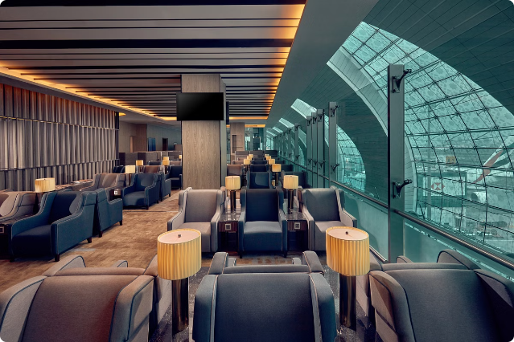

Introduction to Airline Reservation System
The airline reservation system is the backbone of the modern air travel industry, enabling passengers to effortlessly book flights, select seats, and manage their travel plans. This comprehensive system streamlines the booking process, improves operational efficiency, and enhances the overall customer experience.

Slide 2
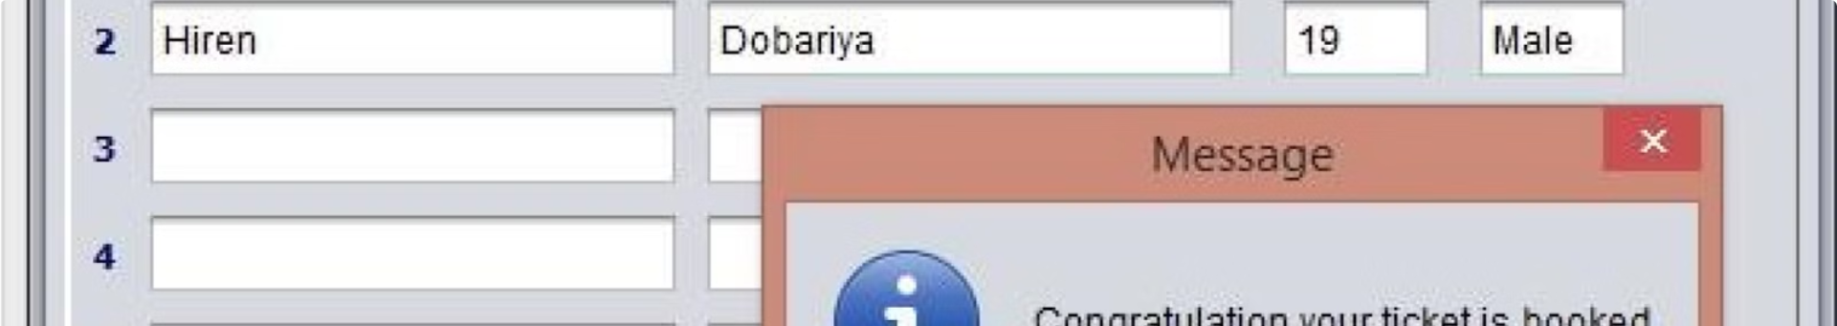
Key Features of the System
Flight Search
Seat Selection
Allows users to search for available flights based on destination, travel dates, and other preferences.
Enables passengers to choose their preferred seats, view seat availability, and manage seat assignments.
Booking and Reservation
Passenger Information
Facilitates the booking process, including payment, ticket issuance, and reservation management.
Stores and manages passenger details, including contact information, frequent flyer programs, and special requests.

Slide 3
Existing System with Disadvantages
Limitations
Inefficiencies
Scalability Challenges
The existing system may lack advanced features, offer a suboptimal user experience, and struggle to keep up with evolving industry demands.
Manual processes, outdated technology, and inefficient data management can lead to delays, errors, and a frustrating customer experience.
The current system may have difficulty accommodating growing passenger volumes, new routes, and changing industry dynamics.

Slide 4

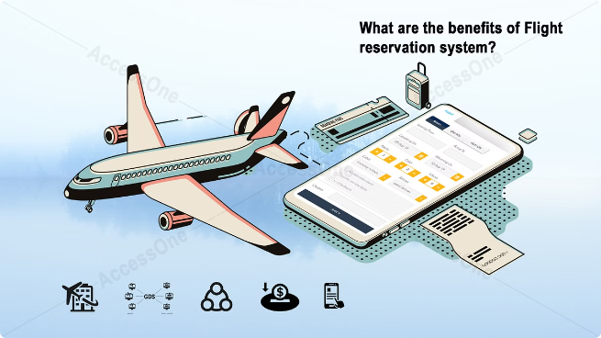
Proposed System with Advantages
1
Enhanced User Experience
Intuitive, responsive, and mobile-friendly interface for seamless booking and management of travel plans.
2
Improved Efficiency
Automated processes, real-time data integration, and intelligent decision-making to streamline operations.
3
Scalability and Flexibility
Ability to accommodate increasing passenger volumes, new routes, and evolving industry requirements.
4
Personalized Services
Tailored recommendations, loyalty program integration, and dynamic pricing to enhance customer loyalty.

Slide 5
User Interface Design
Intuitive Layout
Responsive Design
Personalization Options
Clear organization of search, booking, and management functions for seamless user navigation.
Optimized for desktops, tablets, and mobile devices to provide a consistent experience across platforms.
Customizable user preferences, saved searches, and access to past booking history for convenience.

Slide 6

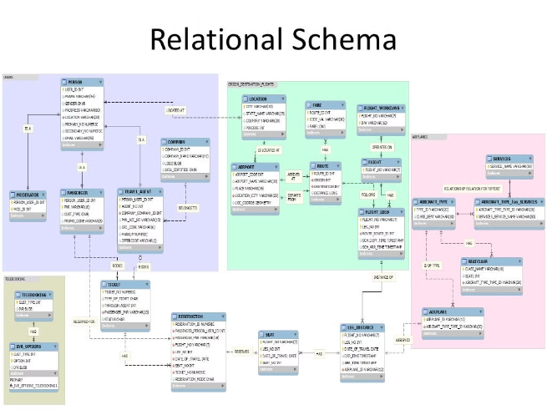
Database Management
1
Data Centralization
Consolidate and store flight schedules, seat inventories, passenger records, and transaction histories in a secure, centralized database.
2
Real-Time Updates
Implement seamless data synchronization to ensure all system components have access to the most current information.
3
Backup and Recovery
Implement robust backup and disaster recovery strategies to safeguard critical data and ensure business continuity.

Slide 7


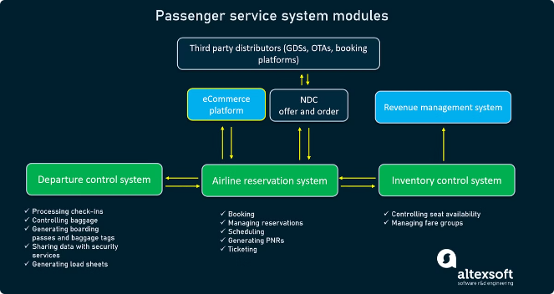



Booking and Reservation Workflow
Flight Search
Allow users to search for available flights based on their travel preferences.
Seat Selection
Enable passengers to choose their preferred seats and view seat availability.
Payment and Ticketing
Facilitate secure payment processing and issue electronic tickets to passengers.
Reservation Management
Provide users with the ability to view, modify, and cancel their reservations.

Slide 8
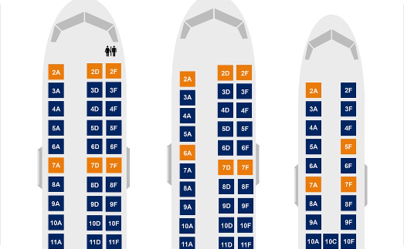
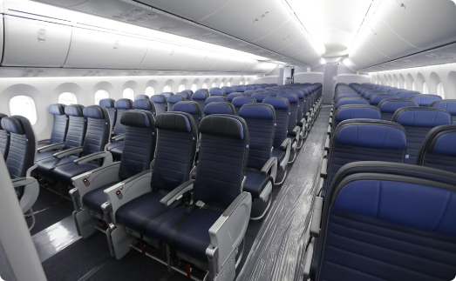
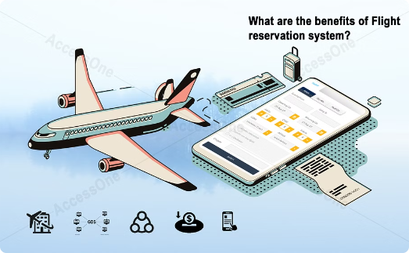
Seat Selection and Availability
Interactive Seat Map
Seat Class Management
Advanced Seat Algorithms
Allow passengers to visually select their preferred seats and view real-time seat availability.
Offer different seating classes (economy, business, first) with corresponding pricing and amenities.
Implement intelligent seat assignment algorithms to optimize cabin utilization and passenger comfort.

Slide 9



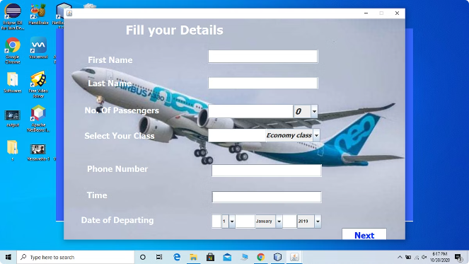


Payment and Ticketing Process
Secure Payment
Provide a variety of payment options, including credit/debit cards, digital wallets, and mobile payments.
Electronic Ticketing
Issue paperless, mobile-compatible tickets to simplify the check-in and boarding process.
Booking Confirmation
Deliver comprehensive booking confirmations with travel details, baggage information, and loyalty program updates.
24/7 Support
Offer dedicated customer support channels for seamless assistance throughout the booking and travel experience.

Slide 10


Conclusion and Future Enhancements
1
Continuous Innovation
Regularly update the system to incorporate the latest technologies, industry trends, and customer preferences.
2
Artificial Intelligence
Leverage AI and machine learning to provide personalized recommendations, predictive analytics, and intelligent decision-making.
3
Multimodal Integration
Seamlessly integrate the airline reservation system with other transportation modes, such as trains, buses, and ridesharing services.
4
Sustainability Initiatives
Explore eco-friendly features, such as carbon offset options and digital documentation, to promote sustainable travel.

